Slide 1
Welcome to our English class .
English 5

Slide 2
Warm up (Guessing Job)

Slide 3
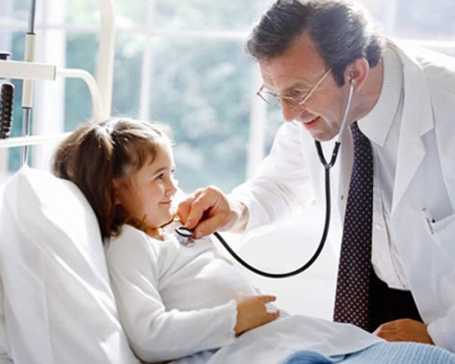
He is a doctor

Slide 4
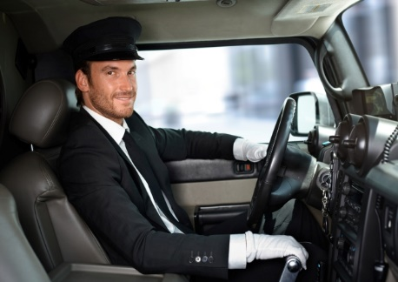
He is a driver

Slide 5
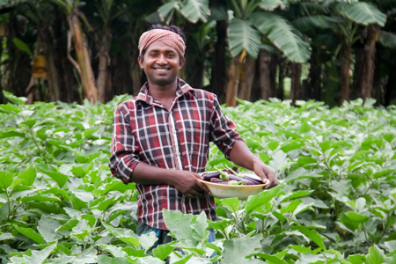
He is a farmer

Slide 6
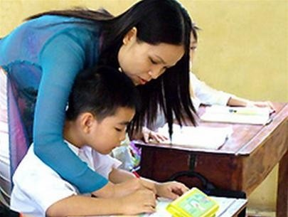
She is a teacher

Slide 7
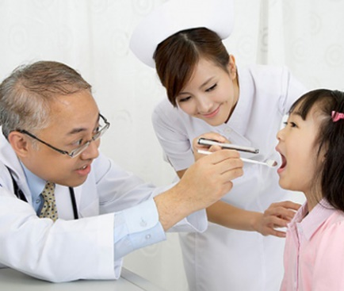
He is a dentist
Notes:
7

Slide 8
They are nurses
Notes:
8

Slide 9
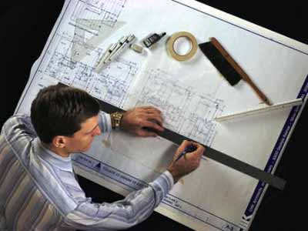
He is an architect
Notes:
9

Slide 10
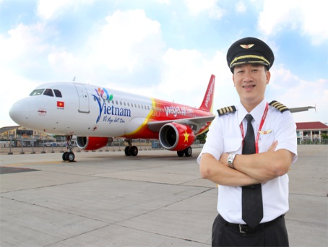
He is a pilot

Slide 11
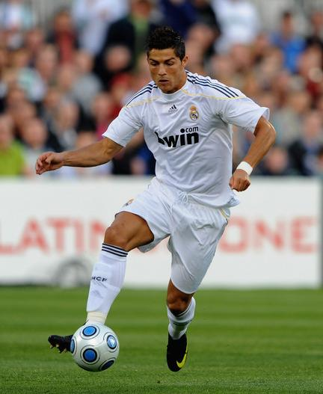
He is a footballer

Slide 12
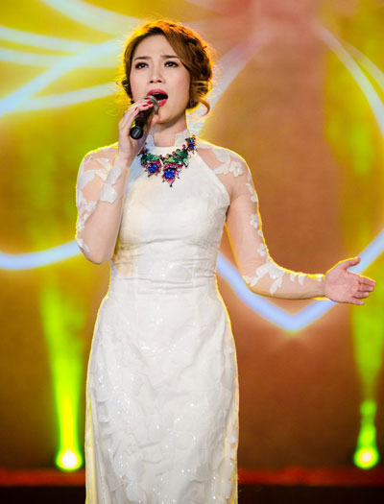
She is a singer

Slide 13
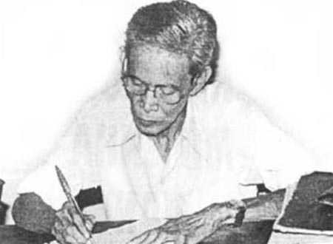
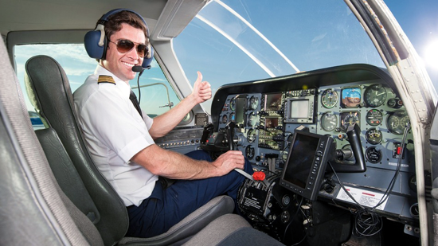
Unit 15: What would you like to be in the future?
Lesson 2 ( 1,2,3 )
Matching words with pictures then read aloud
a, Fly a plane
b, Design buildings
c, Write stories
d, Look after patients
c, Write stories
b, Design buildings
a, Fly a plane
d, Look after patients

Slide 17
3 . Let's talk

Slide 18
Let’s play a game : Do a crossword
1
P I L O T
2
D E N T I S T
3
F O O T B A L L E R
D O C T O R
4
5
A R C H I T E C T
6
F A R M E R
7
D R I V E R
DOWN
: TEACHER

Slide 19
HOMEWORK
- Practise asking and answering about the future job and the reason why.
- Prepare new lesson:
Unit 15- Lesson 3

Slide 20
Thanks for your attendance
Good bye.

Slide 21
1.He flies a plane . He is a …
HOME

Slide 22
2.You have a toothache . You should go to the …
HOME

Slide 23
3.He likes playing football .He’d like to be a … in the future
HOME

Slide 24
4.You have a fever . You should go to the …
HOME

Slide 25
5.He designs buildings. He is an …
HOME

Slide 26
6.He works on a farm . He is a …
HOME

Slide 27
7.He drives a taxi . He is a …
HOME

